Slide 1
Flood recovery and support
Communication toolkit for Aboriginal communities
June 2023

Slide 2
Overview and how to use this toolkit
Overview
Over the past two and a half years, NSW has experienced many events, from bushfires and pandemics to storms and floods, which have significantly impacted communities across the state.
Throughout this period, Aboriginal community groups have played a critical role as trusted sources, sharing important information with their communities.
The Department of Customer Service developed these toolkits to assist this vital communication.
The toolkits contain the latest NSW Government messaging and shareable content on topics such as crisis preparedness, recovery and support, COVID-19 and health, and mental health support.
How to use this toolkit
This toolkit contains a variety of downloadable communication resources in an easy to share format. These can include posters, flyers, factsheets, social media, and videos.
Also included is suggested text for newsletters or websites, which can be easily copied and pasted.
Where possible, resources have been translated into community languages and tailored for Aboriginal communities.
To download resources:
Click on the accompanying link which will take you to the nsw.gov.au website or Dropbox
For nsw.gov.au links, right click on the image on the website for ‘save image’. For Dropbox, on the upper left-hand side you will see a 'download' button
Click ‘save image’ or ‘download'.

Slide 3
Purpose of this toolkit
This updated toolkit helps you share important information with Aboriginal communities impacted by severe weather and floods.
The toolkit contains four sections with the latest information and shareable resources:
Flood preparation
Flood recovery and support
Flood grants and financial support
Mental health and mosquito-borne disease resources.
Stay up to date about all available flood and support by visiting nsw.gov.au/floods.
Quick links to important information:
Financial assistance for individuals, businesses or primary producers
Crisis support for Aboriginal and Torres Strait Islanders
Maintaining health during and after floods and storms
Disaster declared LGAs
Aboriginal mental health support services
School safety updates
SES updates for floods, hazards and emergency plans
Recovery services locations

Slide 4
Flood preparation

Slide 5
Newsletter/web copy: flood preparation
It's important to be prepared for floods and know the flood potential of where you live, work and visit. Find more information about how to prepare your property or business and keep yourself and loved ones safe with a flood safety plan.
Farm Flood Readiness: Local Land Services has updated its Farm Flood Readiness Kit which helps landholders prepare a personalised flood plan. Get useful tips on how to make your property flood-ready. Use the flood readiness checklist to help you identify the risks and hazards on your property and develop an action list. Find out more at the Local Land Services Flood Hub. You can also learn how to make an animal emergency plan by visiting Get Ready Animals on the NSW SES website.
Guides to help your business prepare for and recover from disaster: With the frequency and severity of natural disasters increasing in Australia, it has never been more important for business owners and operators to be prepared for the threat of floods, fires and damaging weather. Having a plan can help prevent damage to valuable stock and get your business back up and running sooner. Download the Get Ready for Disasters kit to help prepare for disasters.
Make an emergency plan for your home or business: One of the most important things to do is to plan ahead so you know what to do in the event of a severe storm. Make an emergency plan for your house or business and share your plan with family, friends and neighbours. Prepare an emergency kit to save time in an emergency and get ready the items you will need during and after an evacuation.
Preparing for before, during and after a flood: It is important to understand the dangers of severe weather events and be ready to respond when flooding occurs. Now is the time to get prepared and know how to receive weather warnings, understand where to go during a flood and what to do when returning to your property. Learn what you can do before, during and after a flood and about the Australian Warning System on the NSW SES website. You can also download the new Hazards Near Me NSW app.
Stay up to date for the latest traffic updates: For the latest traffic updates on state roads and highways, call 132 701, visit the Live Traffic NSW website or download the Live Traffic NSW app. Be aware of increased numbers of trucks on the road, always drive to the conditions and follow the directions of emergency services and road crews on the ground. Plan your journey and use the journey planning tool before your trip. For information on local road closures, visit the relevant council website.

Slide 6
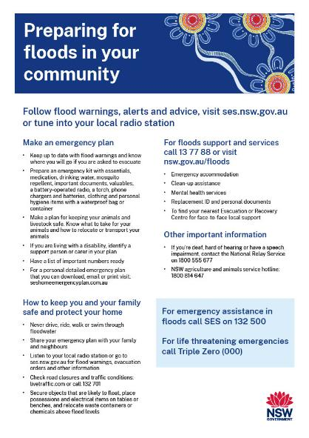
Flyers: flood preparation
Click here to download flyer
(This flyer can be printed in colour or black & white)

Slide 7
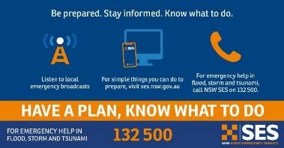
Social content: SES storms and floods preparation
Click here to download social tile
Post: Take the time now to prepare your property for floods and storms – know your risks. You can help reduce damage by preparing your home before severe weather by cleaning gutters and downpipes, check your roof is in good condition and secure or put away loose items.
Have a plan for what you will do and visit ses.nsw.gov.au to find information. For emergency help in floods and storms, call SES on 132 500.

Slide 8
Flood recovery and support

Slide 9
Newsletter/web copy: flood recovery and support
As our communities recover from the impacts of extreme weather and floods, it's important to know what support and information is available. To find flood recovery and clean-up advice visit nsw.gov.au.
Mental health support after a flood: Natural disasters, cleaning up and recovery can take a toll on your mental health and wellbeing. If you or someone you know needs to talk to someone, call 13YARN on 13 92 76 or Lifeline on 13 11 14.
Rebuilding and repairing your home: Damage to your home from floods, debris and mould can be extensive and take weeks to repair. It is important to stay safe when you return home and during flood clean-up. Some property repairs can be done quickly, without approval from your local council. For more information on what types of work can be done and further guidance to rebuild your home visit nsw.gov.au.
Flood Property Assessment Program: Free structural assessments are available for damaged buildings in eligible Local Government Areas (LGAs) damaged by floods beginning in February and June 2022. This is an opt-in program that provides a detailed assessment report, including a comprehensive scope of repair works and estimated repair costs.
Recovery assistance points: Face-to-face recovery support is available for individuals, farmers and businesses affected by natural disasters, including storms, floods and bushfires. To find a recovery assistance point visit the Service NSW recovery centres page or call 13 77 88.
Advice and information for flood impacted farmers: Farmers and rural landholders impacted by flooding can access advice and information to support their recovery by visiting the Local Land Services Flood Hub. The hub houses technical advice on all aspects of agricultural flood recovery, from livestock and cropping to natural resource management including erosion and weeds. To access the hub, visit lls.nsw.gov.au.
What to do immediately after a flood: Never drive, ride or walk through floodwater. Most flood-related deaths occur when people enter floodwater, including kids playing in floodwater. Follow these steps to help recover after a major flooding event, once you’re no longer in immediate danger. It is important to follow advice from emergency services when returning to flood-impacted households or businesses and staying safe during clean up.
Donate to GIVIT: It's the the smart way to support recovery after devastating storms and flooding and help people directly impacted.

Slide 10
Newsletter/web copy: flood clean-up advice
As our communities recover from the impacts of extreme weather and floods, it's important to know what support and information is available. To find flood recovery and clean-up advice, including accommodation and financial support, visit nsw.gov.au.
Staying safe during flood clean-up: Floodwater and mud can contain garbage, chemicals, debris, sewage and other hazardous contaminants, such as disease-causing bacteria, fungi and viruses. Flooding can also lead to an increase in spiders and snakes. If you are bitten, stay calm and call Triple Zero (000).
Cleaning up debris and waste: Local councils can help direct residents to dispose of flood-damaged rubbish and other waste. The waste levy can be waived for waste arising as a result of storms and floods subject to a natural disaster declaration. Check your local landfill websites for opening hours and whether there are special requirements for disposing of flood-damaged waste. For more advice and information on cleaning your flood affected property, and dealing with chemical waste and hazardous materials, visit epa.nsw.gov.au.
Dealing with asbestos in flood-affected areas: Be aware and stay safe around asbestos after emergencies and disasters. Asbestos is hazardous but you can manage it safely. It is found in many parts of homes built before 1990 including walls, ceilings and roofing, or in products such as pipes, electrical conduits, eaves, or backing under vinyl flooring. Before you start cleaning up, use the Asbestos Checker or if possible, have a licensed asbestos assessor inspect your property. Visit asbestos.nsw.gov.au to find a licensed asbestos assessor, removalist, or accredited testing lab, or call the Asbestos hotline on 1800 272 378.
How to remove asbestos immediately after a flood or storm: Using a licensed asbestos removalist is the best way to remove asbestos, but this may not be possible following a flood or storm. For more information and advice download this fact sheet or visit asbestos.nsw.gov.au.

Slide 11
Newsletter/web copy: Resilient Australia Awards
The Resilient Australia Awards celebrate and promote initiatives that build whole of community resilience to disasters and emergencies around Australia, as well as images capturing resilience in action.
The awards have been running since 2000 and are a great recognition of the outstanding contribution that organisations, government bodies, associations, agencies, as well as individuals, make in times of duress and uncertainty.
Submissions are open for the 2023 Resilient Australia Awards. The NSW Reconstruction Authority is the NSW state convenor for the awards and is calling for submissions.
Submissions cover seven categories:
Business
Community
Government
Local Government
Schools
Mental health and wellbeing
Photography.
Entries close on Tuesday 13 June 2023. Find out more and submit an entry at www.aidr.org.au/raa.

Slide 12
Social content: Resilient Australia Awards
Click here to download social tile
Post: Submissions are now open for the 2023 Australian Institute for Disaster Resilience Resilient Australia Awards!
The Resilient Australia Awards celebrate initiatives that foster community resilience to disasters and emergencies across 7 award categories: community, business, government, local government, school, photography, and mental health and wellbeing.
Do you have an initiative that shows resilience in action? Make your submission here: www.aidr.org.au/raa by 13 June 2023.
#RAA23

Slide 13
Social content: Resilient Australia Awards
Click here to download social tile
Post: The Resilient Australia Awards highlight initiatives across the country that are making communities safer, more connected, and better prepared.
There are seven nomination categories: community, business, government, local government, school, photography, and mental health and wellbeing.
Don’t miss you chance to share your resilience building project as part of #RAA23. Make a submission and share your story today: www.aidr.org.au/raa

Slide 14
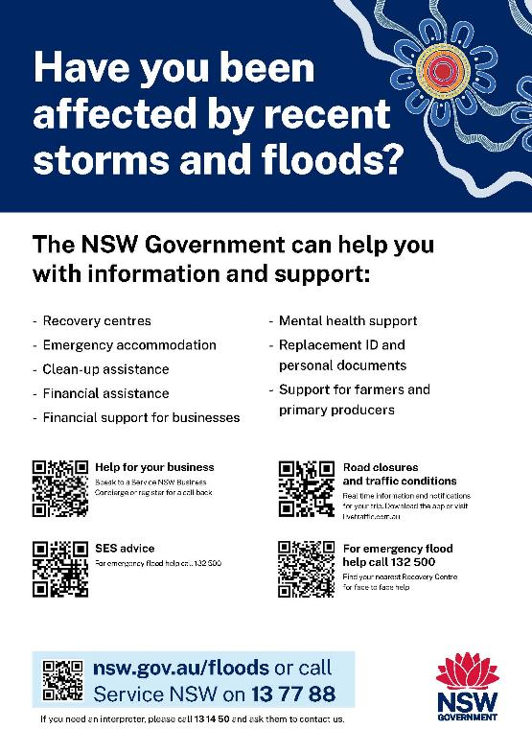
Poster: flood support for communities
Click here to download A4 poster

Slide 15
Flood grants and financial support

Slide 16
Newsletter/web copy: financial support for businesses
If your business, community group or not-for-profit has been affected by severe weather and flooding, there are grants, payments and other assistance you can apply for. A Service NSW Business Concierge can provide you with guidance on eligibility criteria and available support.
Disaster Assistance Finder: Find the support that suits your circumstances by using the Disaster Assistance Finder which now enables people to identify themselves as Aboriginal or Torres Strait Islander and find out about relevant support and services.
Disaster relief loans and subsidies: Organisations or businesses impacted by a disaster may be eligible for concessional loans or subsidies. This includes loans for small businesses (up to $130,000), non-profit organisations (up to $25,000), and the Donated Fodder Transport Subsidy. For a list of Local Government Areas eligible for disaster assistance refer to the NSW Rural Assistance Authority’s Declared Natural Disasters webpage or call 1800 678 593.
Disaster recovery small business grant: If you’re a small business or a not-for-profit organisation in a defined disaster area and have been impacted by storms and floods beginning in February 2022, June 2022, or August 2022, you may be eligible for a storm and flood disaster recovery grant. The disaster recovery grant of up to $50,000 is to help pay for the costs of clean-up and reinstatement of operations.
Flood Property Assessment Program: Free structural assessments are available for damaged buildings in eligible Local Government Areas damaged by flooding in February and June 2022. This is an opt-in program that provides a detailed assessment report, including a comprehensive scope of repair works and estimated repair costs.
Northern Rivers medium size business grant: Organisations and businesses in the Northern Rivers impacted by storms and floods beginning in February 2022 may be eligible for the medium size business grant. This grant of up to $200,000 is to help pay for the costs of clean-up and reinstatement of a medium business or not-for-profit organisation. Organisations must be located in eligible Northern Rivers Local Government Areas.
Northern Rivers commercial property return to business support grant: If you're a commercial property owner in the Northern Rivers and you were directly impacted by storms and floods beginning in February to March 2022, you may be eligible for the Northern Rivers commercial property return to business support grant.

Slide 17
Newsletter/web copy: financial support for farmers and primary producers
There is a range of grants and payments for farmers and primary producers affected by storms and floods in NSW. Find the support that suits your circumstances by using the Disaster Assistance Finder or the grants and funding finder.
Disaster relief loans: Primary producers directly affected by a declared natural disaster may be eligible for low interest loans of up to $130,000. For a list of Local Government Areas eligible refer to the NSW Rural Assistance Authority’s Declared Natural Disasters webpage or call 1800 678 593.
Natural disaster transport subsidy: Farmers that were affected by a declared natural disaster event can claim up to $15,000 to put toward the cost of transporting fodder or water to an affected property, stock to sale or slaughter, or stock to/from agistment. Check the list of disaster-declared Local Government Areas for more information. Farmers affected by the February 2022 or June 2022 floods can claim up to $25,000 via the NSW Rural Assistance Authority (1800 678 593).
Rural Landholders Grant: Landholders and oyster farmers in disaster-declared Local Government Areas affected by floods may be eligible for the Rural Landholders Grant. This grant is available for producers and landholders who receive at least $20,000 income from primary production and do not qualify for support through existing recovery programs. Applicants are encouraged not to self-assess and to submit an application so the NSW Rural Assistance Authority can determine eligibility. Applications close 30 June 2023. For more information, visit NSW Rural Assistance Authority website.
Special Disaster Grants: Primary producers may be eligible for the Special Disaster Grant (up to $75,000). The grants are available in disaster-declared Local Government Areas via the NSW Rural Assistance Authority (1800 678 593). Primary producers may be eligible for $25,000 up-front, with a further $50,000 available with submission of valid tax invoices for the full $75,000 on offer. Applications close 30 June 2023.
Critical Producer Grant: This recovery program is to help primary producers and primary production enterprises impacted by the floods beginning February 2022 onwards to rebuild and recover in the medium to longer term. Funding complements the $75,000 Special Disaster Grant and will support NSW agriculture, horticulture, aquaculture and forestry industries. Applications close 30 September 2023.
Flood Property Assessment Program: Free structural assessments are available for damaged buildings in eligible Local Government Areas damaged by flooding in February and June 2022. This is an opt-in program that provides a detailed assessment report, including a comprehensive scope of repair works and estimated repair costs.

Slide 18
Newsletter/web copy: financial support for individuals
Grants and payments are available to people impacted by severe weather and flooding in disaster-declared Local Government Areas. For more information visit nsw.gov.au or use the grants and funding finder.
Disaster Assistance Finder: Find the support that suits your circumstances by using the Disaster Assistance Finder. The Disaster Assistance Finder now enables people to identify themselves as Aboriginal or Torres Strait Islander and find out about relevant support and services.
Flood Recovery Rental Support Payment: Available for eligible NSW residents unable to live in their home and need help to pay for short-term accommodation bookings. Support for people impacted by the August and September 2022 floods is now available for additional Local Government Areas.
Flood Recovery Back Home Grant: This financial assistance can help cover the costs of restoring a flood damaged property to a habitable condition or replacing essential household items. For more information on eligible Local Government Areas and application closing dates visit the Service NSW website.
Disaster Relief Grant: This grant helps people whose home or essential household items have been destroyed or damaged by a storm or flood in eligible disaster-declared Local Government Areas. For more information and eligibility criteria, visit the Service NSW website.
Emergency or temporary accommodation after a flood: Accommodation support is available to people affected by floods. This includes emergency accommodation and longer term temporary accommodation such as temporary housing sites, at-home caravans or pods on private property. If you need emergency accommodation, visit a recovery centre or call Service NSW on 13 77 88. For more information on temporary housing programs visit nsw.gov.au.
Resilient Homes Program: Financial assistance is available to homeowners to improve the flood-resilience of residential properties in the Northern Rivers. Eligible homeowners may be offered assistance for home buyback, home raising or home retrofit. These investments will be complemented by Resilient Land Program.
Flood Property Assessment Program: Free structural assessments are available for damaged buildings in eligible Local Government Areas damaged by flooding in February and June 2022. This is an opt-in program that provides a detailed assessment report, including a comprehensive scope of repair works and estimated repair costs.
Travel and accommodation support for specialist medical treatment: Financial assistance available to eligible people where travels for specialist medical treatment have been impacted by floods. For more information, visit the NSW Health website.

Slide 19
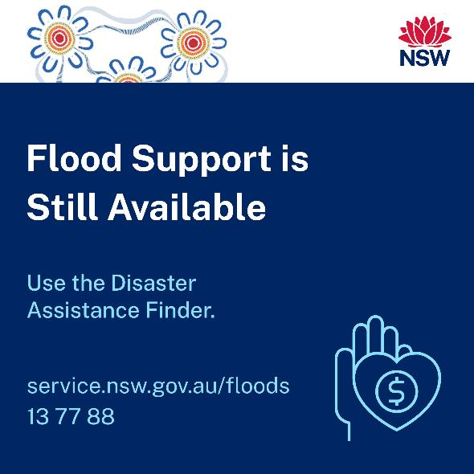
Social content: flood support for individuals
Click here to download social tile
Click here to download social tile
Post: Were you affected by the storms and floods in 2022? Financial support is still available. We’re here to help you. Learn more at service.nsw.gov.au/floods
Post: Were you affected by the storms and floods in 2022? Answer 7 questions for a personalised list of support options. Learn more at service.nsw.gov.au/floods

Slide 20
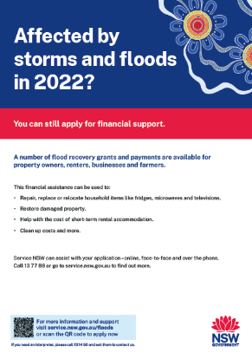
Poster and flyer: flood grants and financial support
Click here to download A3 poster
Click here to download A4 flyer

Slide 21
Mental health and mosquito-borne disease resources

Slide 22
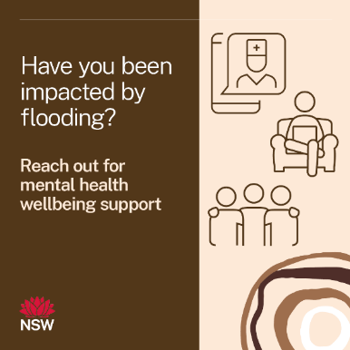
Social content: mental health support
Click here to download social tile
Post: There’s no shame in not being ok. Support is a phone call away.
If you need to talk to someone you can call:
13YARN on 13 92 76
Beyond Blue on 1800 512 348
Lifeline on 131 114
Kids Helpline on 1800 55 1800 if you’re under 25 and needing some support.
If you or someone you know is in immediate danger, please call 000 or go to your nearest hospital emergency department.
For more information on mental health services available to you, visit nsw.gov.au

Slide 23
Social content: mental health support
Click here to download social tile
Post: It's normal to feel overwhelmed, angry or upset after experiencing the trauma and loss caused by a natural disaster.
You should seek professional support if you need it, but there are a few things you can do each day to help you cope and process your emotions:
Give yourself time to process what has happened
Ask for support from people you love and trust, as they can provide a listening ear or help you with daily tasks that may seem too hard to manage as you navigate your emotions
Avoid spending lots of time alone - being around other people after a traumatic experience will mean you're less likely to experience poor mental health and wellbeing
Re-create a routine to help you build control over your personal situation
Take care of your physical, emotional and spiritual needs, self-care is very important
Avoid an overload of media around the event as this can re-traumatise you.
Remember that you are not alone, and there is always support available.
Reach out to 13YARN (13 92 76) and for other support visit nsw.gov.au
Click here for an extra social tile option

Slide 24
Social content: mosquitoes increase with floods
Click here to download social tile
Click here to download social tile
Post: Flood waters can attract mosquitoes, increasing your risk of being bitten and becoming sick from the viruses they can carry. The best way to protect yourself against mosquito-borne diseases is to prevent mosquito bites. Learn how at nsw.gov.au
Post: A free JEV vaccine is available for people who are cleaning up water after floods in high risk LGAs. Immunity can take up to four weeks – contact your GP today and learn more about eligibility at nsw.gov.au

Slide 25
Social content: mosquito resources
Click here to download social tile
Click here to download social tile
Click here to access more Aboriginal resources
Post: Heading out? Enjoy the great outdoors, mozzie bite free. Take the steps to protect and keep mozzies away from you and your mob – Spray up, Cover up and Screen up. Learn more at nsw.gov.au
Post: Heading out? Enjoy the great outdoors, mozzie bite free. Take the steps to protect and keep mozzies away from you and your mob – Spray up, Cover up and Screen up. Learn more at nsw.gov.au

